Slide 1
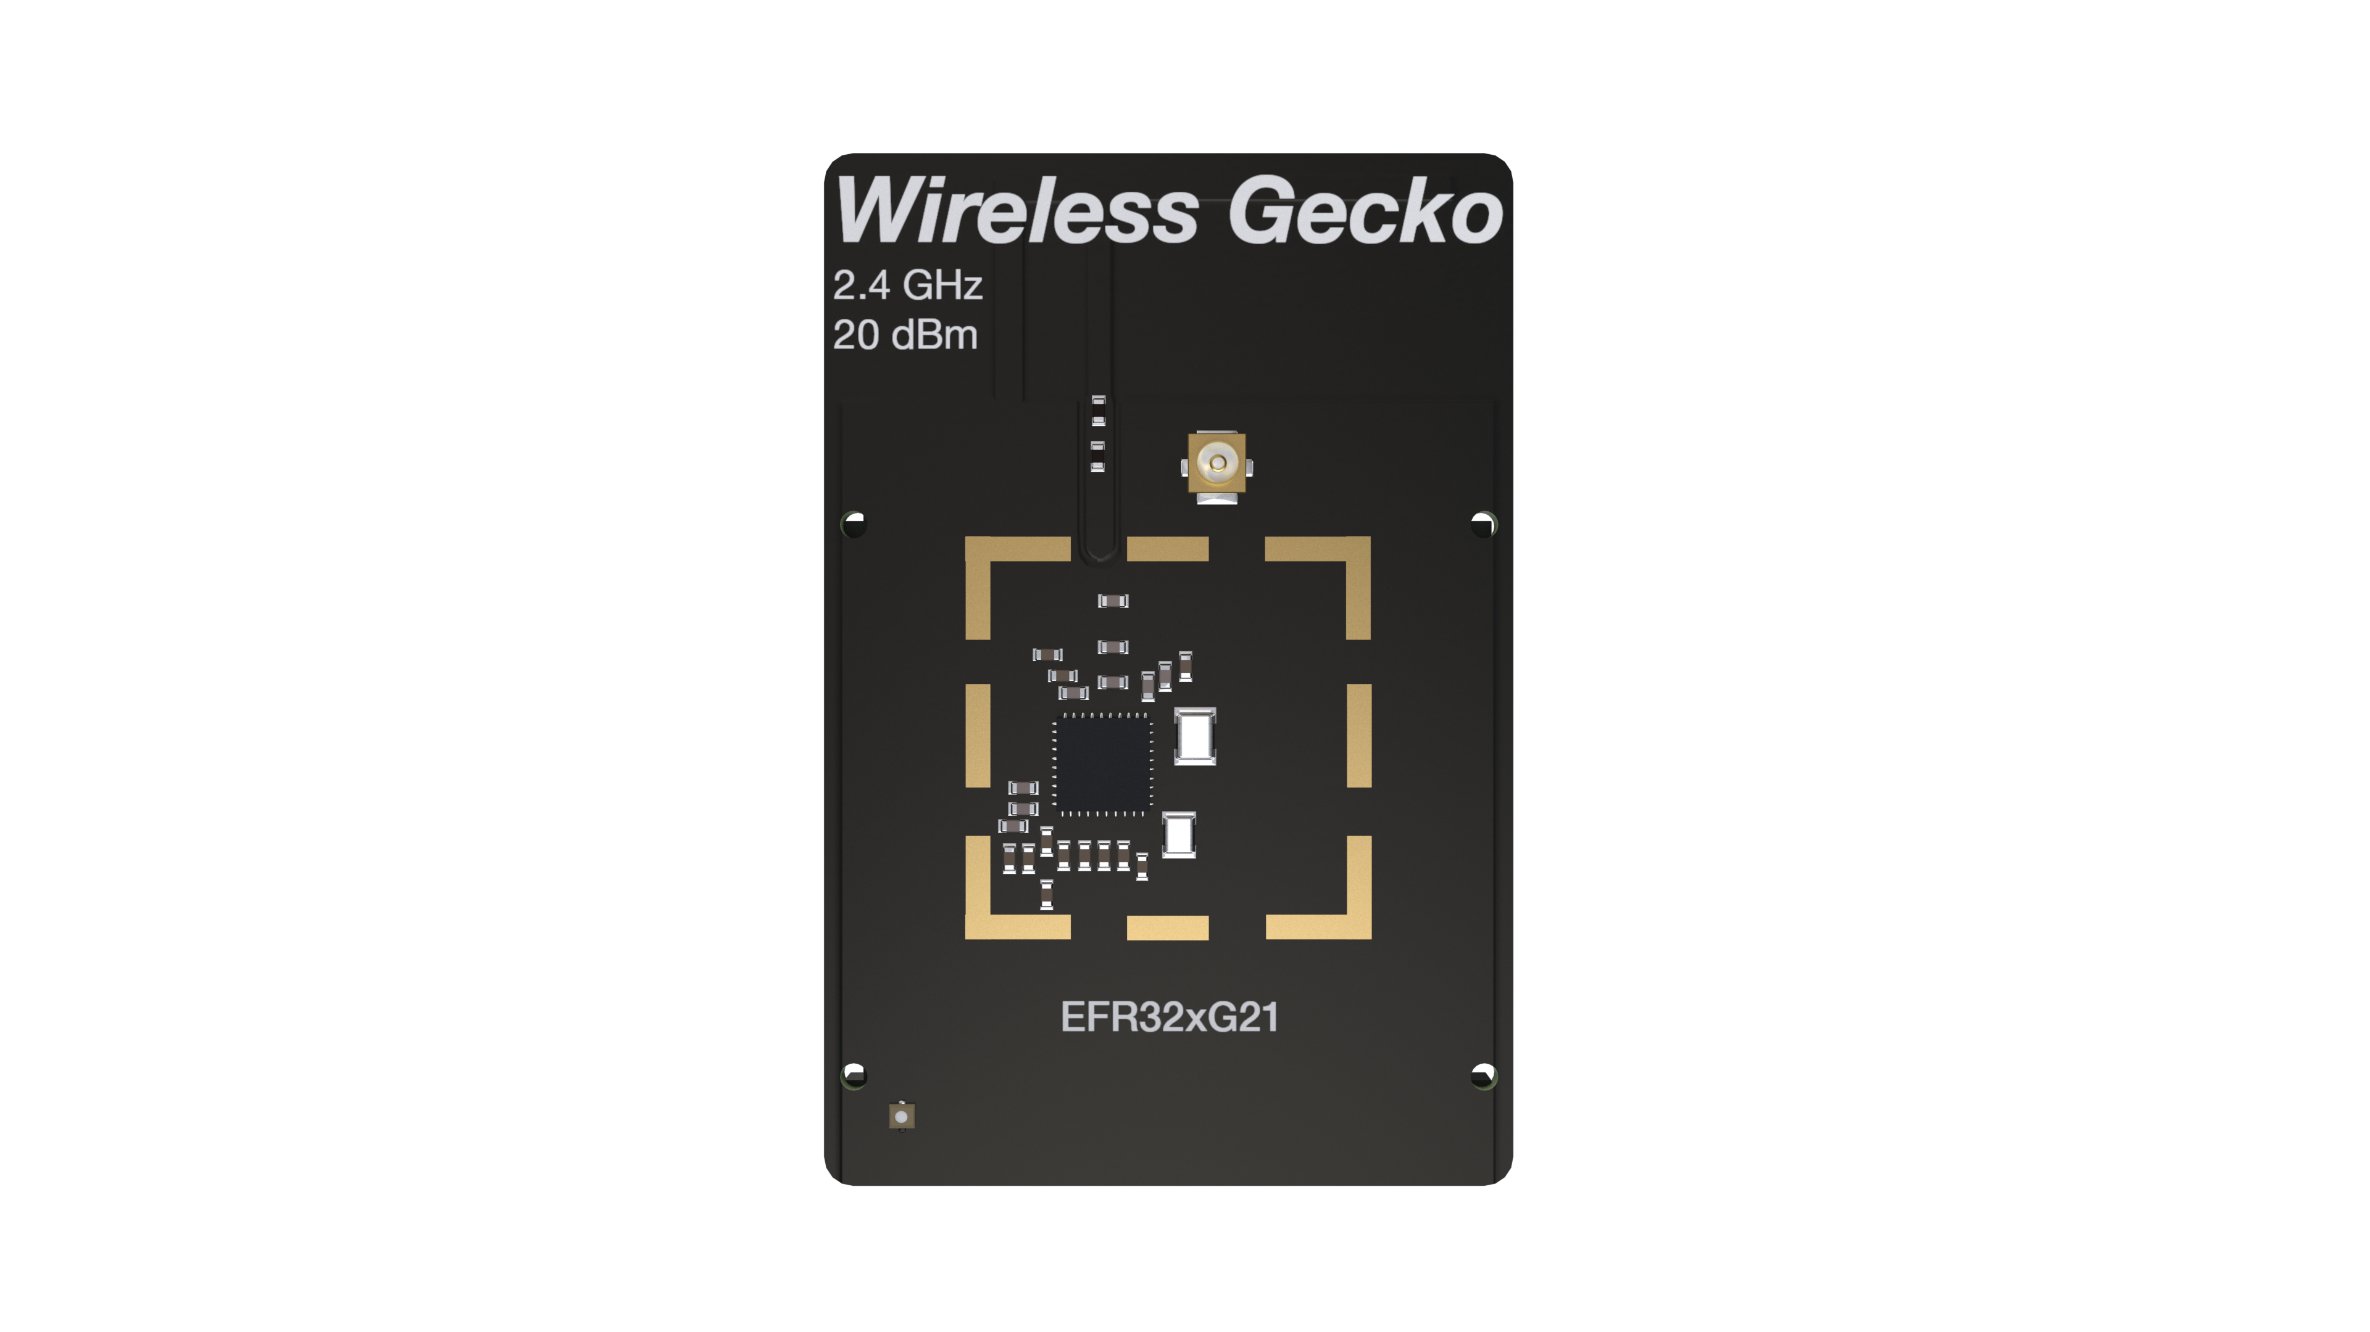
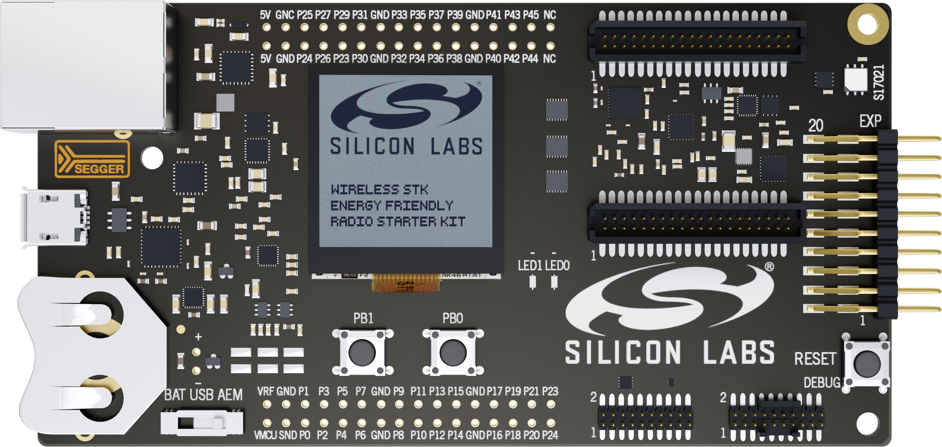
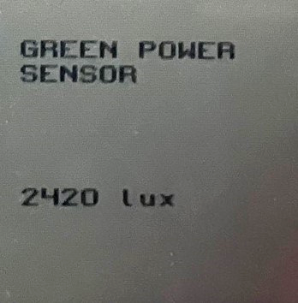
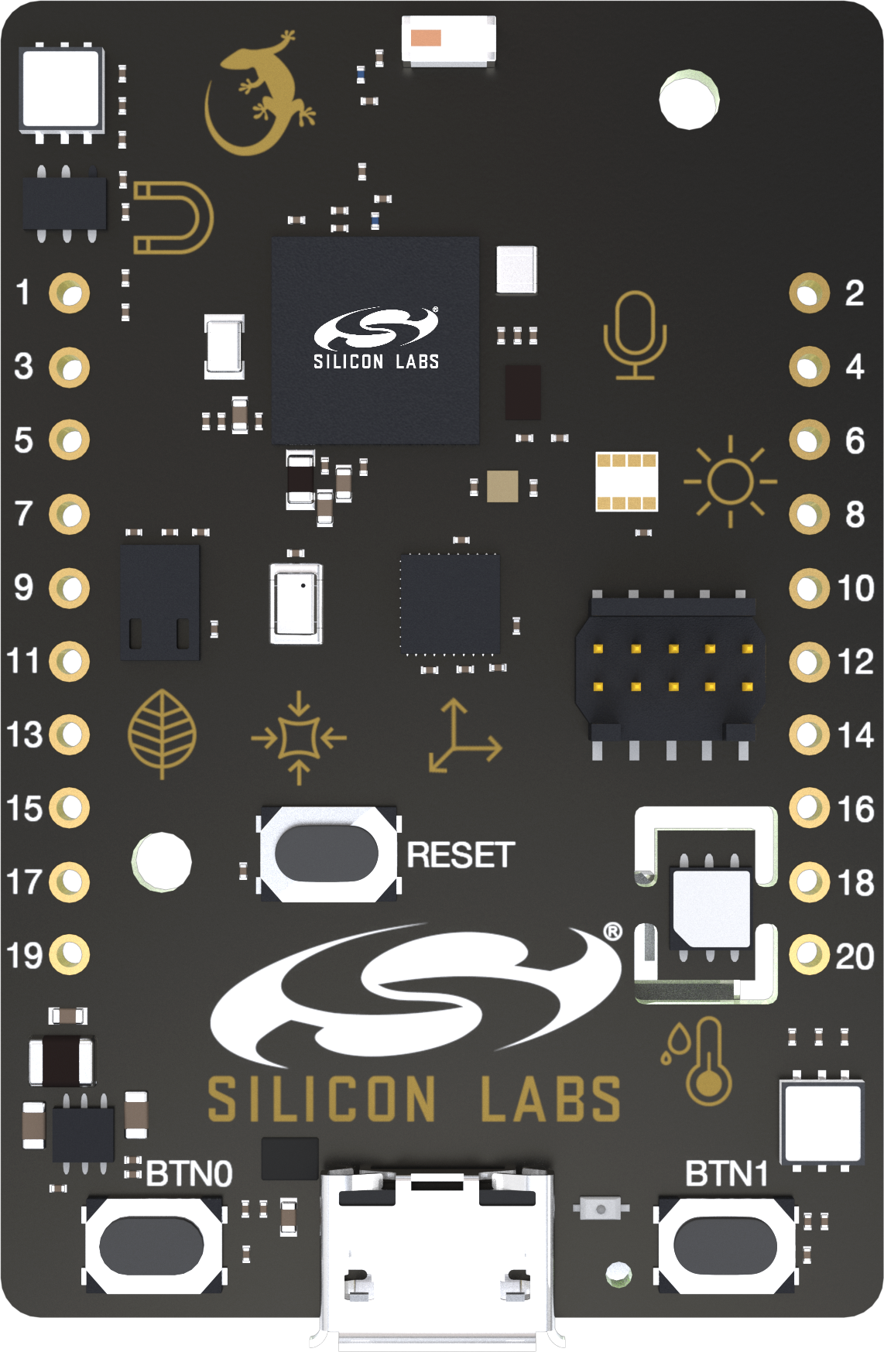

Zigbee Router Combo (GP Proxy + Sink)
Light sensor node
BRD4001 + BRD4180A
Thunderboard Sense 2
BRD4166A
Si1133
UV and Ambient light sensor
PB0 & PB1
PB1 & PB0

